Slide 1
Blazor showcase
Poetic love story about a c# developer penetrating front-end fortresses, guarded by angular/react/vue experts, using backend-like c# code (and bits of Razor)
Presented by Antonin Jelinek
(like & subscribe)

Slide 2
Before we begin
Questions and comments at the end, please, there will be time.
Acknowledge inspiration for demo – Steven Sanderson
A true story why being open minded usually pays off
WASM Blazor only ahead

Slide 3
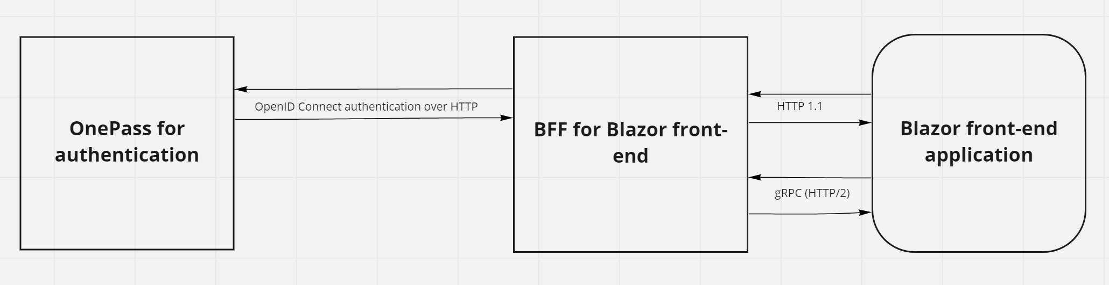
Demo – architecture overview

Slide 4
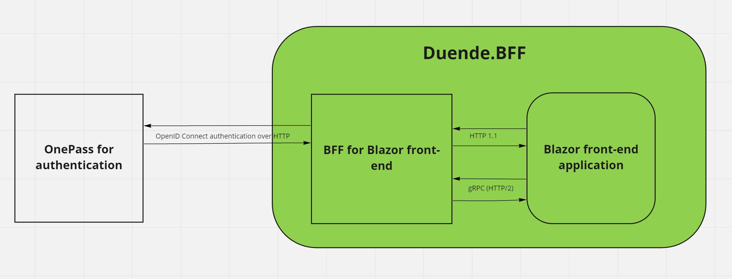
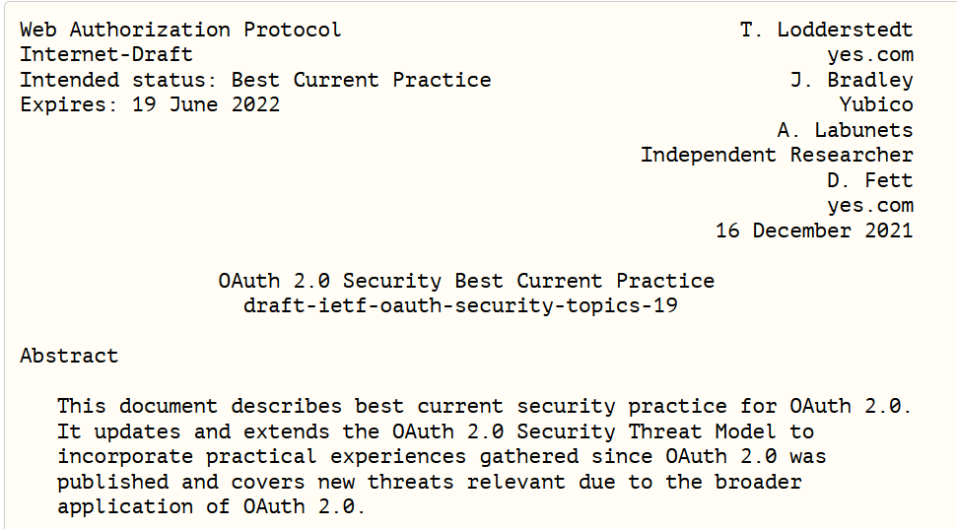
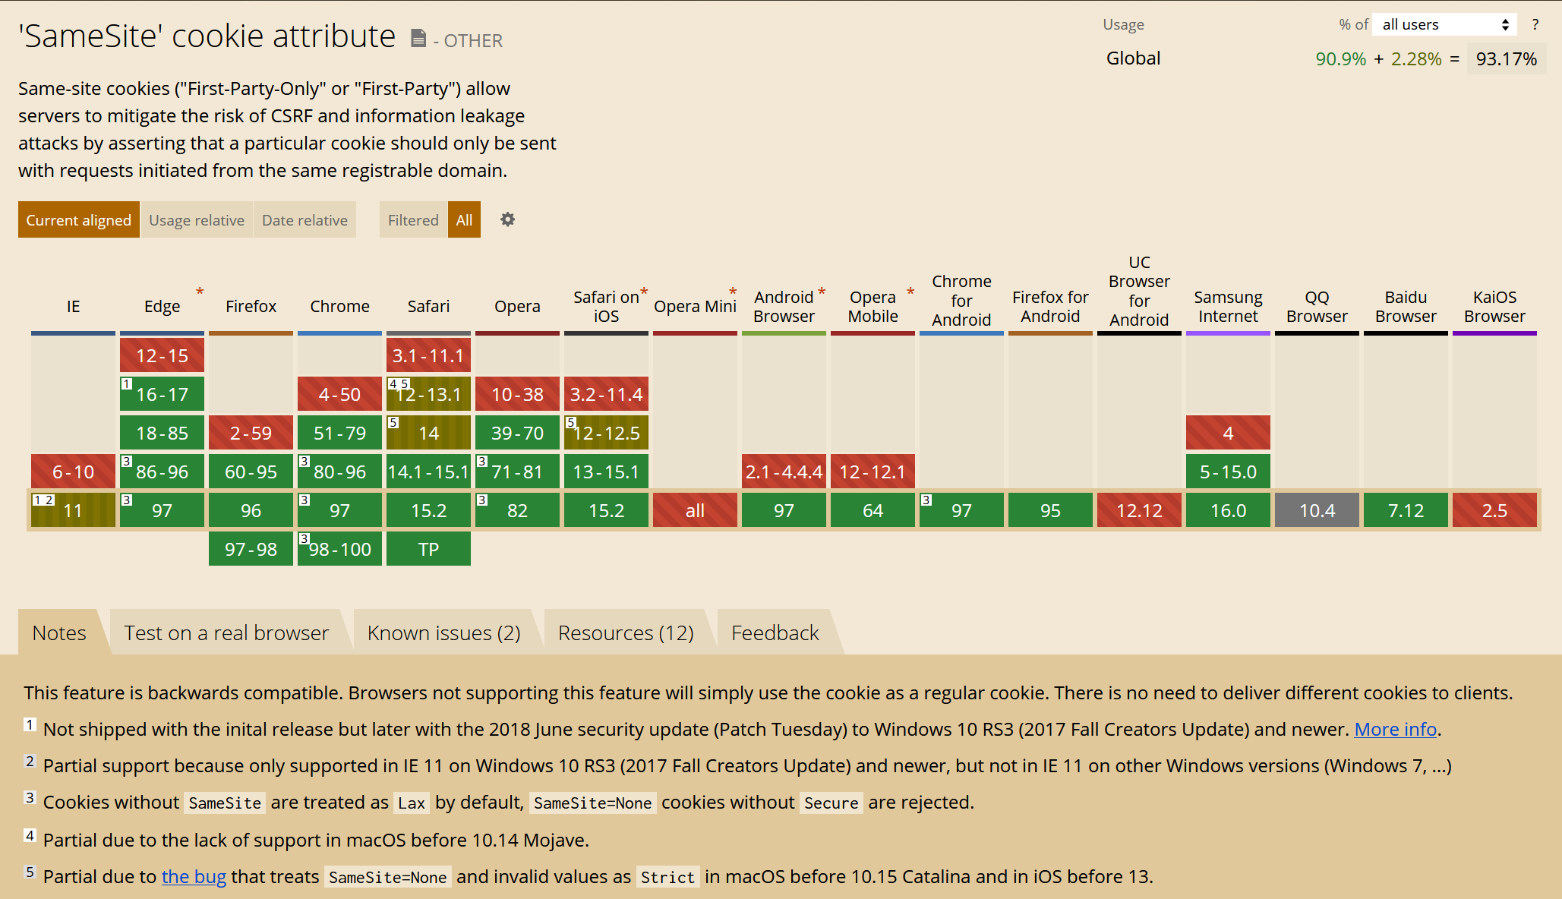
New ways of securing your SPA application
Brief history (cookies -> session -> csrf -> token)
oidc-client.js
IETF recommendation (https://datatracker.ietf.org/doc/draft-ietf-oauth-security-topics/)
Same-Site cookies
What is Duende
What is Duende.BFF
YARP
Demo
Implementation
details

Slide 5
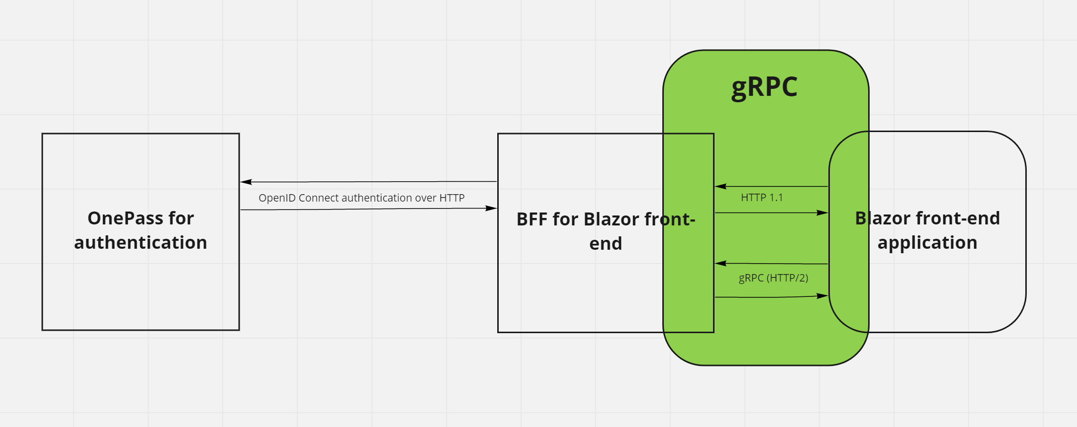
A is for Apple, gRPC is for communication
What is HTTP/2, gRPC and protobuf
gRPC tooling in Visual Studio 2022 and other improvements in .Net 6 – James Newton-King
Contract first vs. code first
Demo
Implementation details

Slide 6
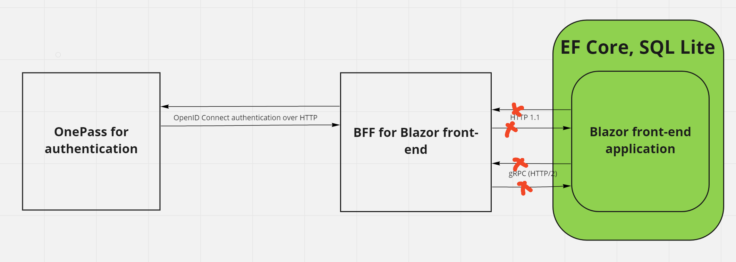
Entity Framework Core and other goodies on (disconnected) client side
AOT compilation compiles your code directly to WebAssembly
Native dependencies support for Blazor WebAssembly apps
Generate Angular and React components
Demo
Implementation details

Slide 7
Pros and cons – Duende.BFF
Unified way for securing SPA applications
Follow industry standard recommendations
Easy to implement
Open source
Duende licensing

Slide 8
Pros and cons – gRPC
Easy to implement
Way less code than REST API
Streaming
No HttpClient (factory) registration hell
HTTP/2 may be a big no-no (AWS Lambdas, …)
Less visibility into transferred data
gRPC-Web streaming limitations

Slide 9
Pros and cons – Blazor
Full c# (plus Razor) code
Feels like long-lost home for WebForms/MVC developers
Paid + big variety of open source component libraries
App startup / download size
Tooling, esp. debug experience
Young framework
Potential data and business logic leakage
AntDesign Blazor is 💩

Slide 10
Resources
Steven Sanderson - New Blazor WebAssembly capabilities in .NET 6 https://www.youtube.com/watch?v=kesUNeBZ1Os
Dominick Baier - Using the BFF pattern to secure SPA and Blazor Applications - Dominick Baier - NDC Oslo 2021 https://www.youtube.com/watch?v=UBFx3MSu1Rc
Christian Weyer - Blazor & gRPC - Code-first .NET SPA developer productivity - Christian Weyer - NDC London 2021 https://www.youtube.com/watch?v=t2AMDthNSl8 (gRPC code first)
NDC Conferences YouTube video channel - https://www.youtube.com/c/NDCConferences/videos
Blast off with Blazor! 🚀 - Supercharged Enterprise UIs using AntDesign with Luke Parker https://www.youtube.com/watch?v=lJojMo9RpoA – contains biased but comprehensive review of open source Blazor components
Demo source code - https://github.com/senseicz/BlazorShowcase
YARP - https://devblogs.microsoft.com/dotnet/announcing-yarp-1-0-release/
gRPC-Web - https://docs.microsoft.com/en-us/aspnet/core/grpc/browser?view=aspnetcore-6.0

Slide 11
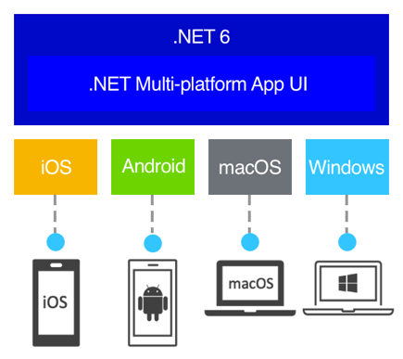
… one other thing to mention
.NET MAUI
.NET MAUI Blazor

Slide 12
Imagine that as a seasoned backend c# developer, you can now write, run and deploy [disconnected] web, Windows desktop, iOS, Android and macOS applications in one single project using backend-like c# code, incl. Entity Framework, etc. and bits of Razor.

